Slide 1
University management System
Salesforce Adminstrator Project

Slide 2
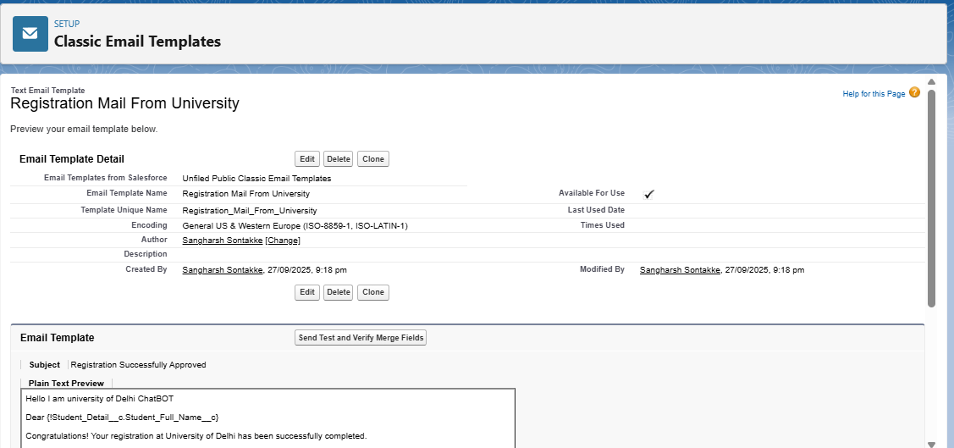
Email Template

Slide 3
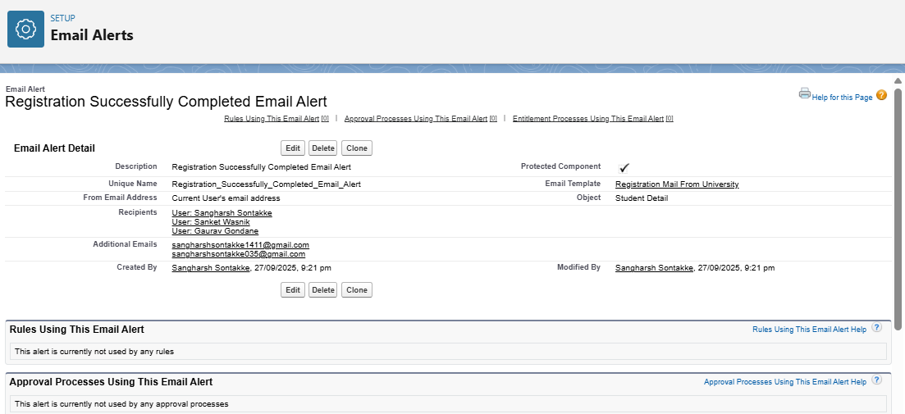
Email Alert

Slide 4
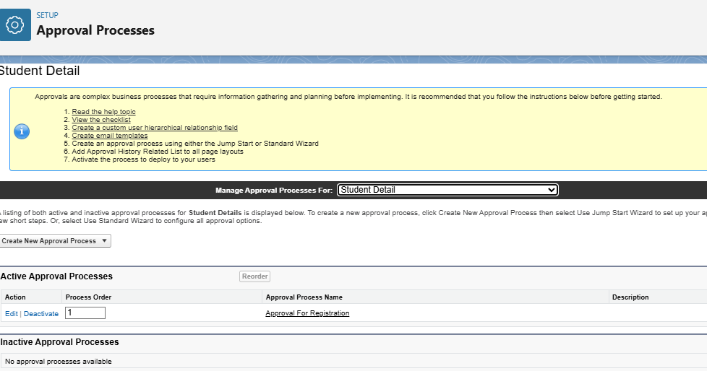
Approval Processs

Slide 5
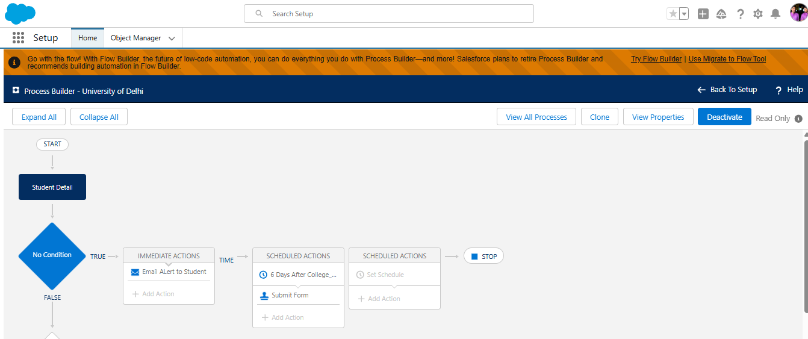
Process Builder

Slide 6
Introduction
The University Management System built on Salesforce is designed to streamline and automate various academic and administrative processes within a university. Managing student data, faculty information, admissions, courses, and examinations manually can be time-consuming and prone to errors. By leveraging Salesforce’s cloud-based CRM platform, the University Management System provides a centralized, secure, and user-friendly solution for managing university operations.
This project aims to enhance efficiency by enabling students, faculty, and administrators to interact seamlessly on a single platform. Key modules include student registration, admission management, course allocation, attendance tracking, examination results, fee management, and communication tools. With Salesforce’s automation, workflows, and reporting capabilities, the system ensures real-time access to information, reduced paperwork, improved decision-making, and better collaboration among stakeholders.
In short, the University Management System on Salesforce transforms traditional education management into a modern, cloud-based, and scalable solution, ensuring transparency, accessibility, and improved academic experiences for students and staff.

Slide 7
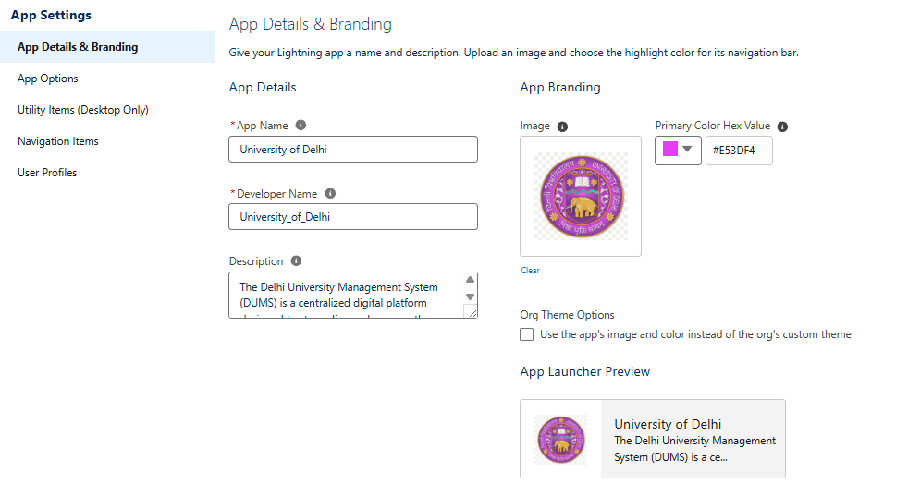
📌 University Management System – Lightning App
App Name: University Management System (UMS)
Platform: Salesforce Lightning Experience
Purpose: To manage students, faculty, courses, admissions, exams, and fees in a single cloud-based solution.

Slide 8
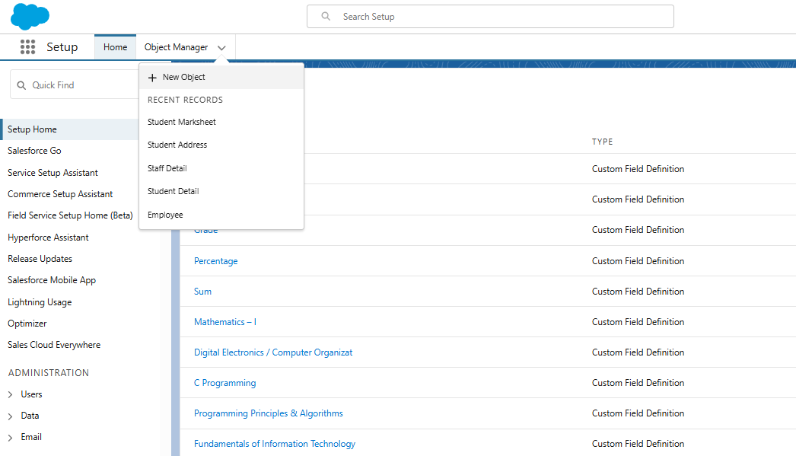
Student__c ↔ Course__c (Many-to-Many, via Junction Object Enrollment__c)
Student__c ↔ Exam__c (Many-to-Many, via Result__c)
Student__c ↔ Fee__c (One-to-Many)
Faculty__c ↔ Course__c (One-to-Many)
Department__c ↔ Faculty__c & Course__c & Student__c (One-to-Many)
📌 Custom Objects for University Management System

Slide 9
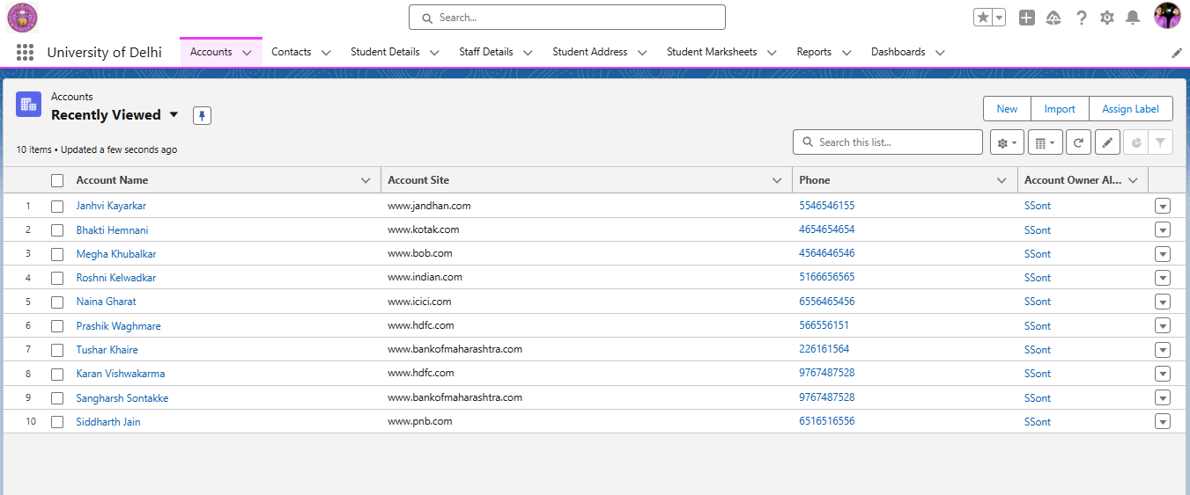
Standard Objects – Account Section

Slide 10
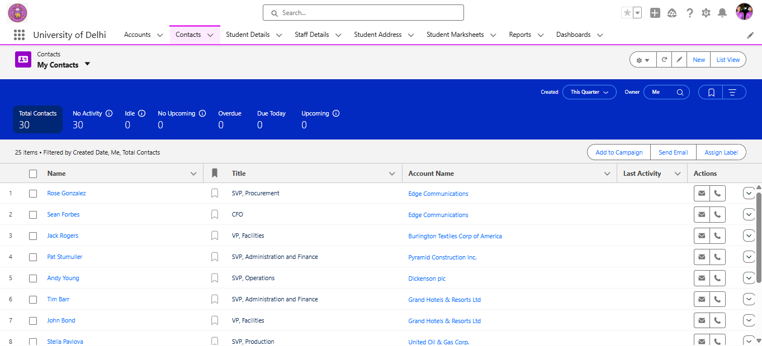
Standard Object – Contacts Section

Slide 11
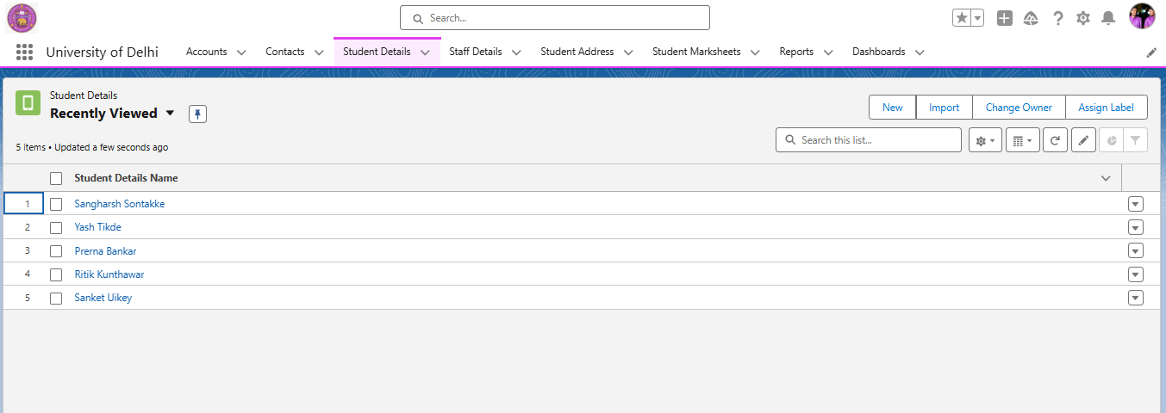
Custom Object – Student Details Page Layout

Slide 12
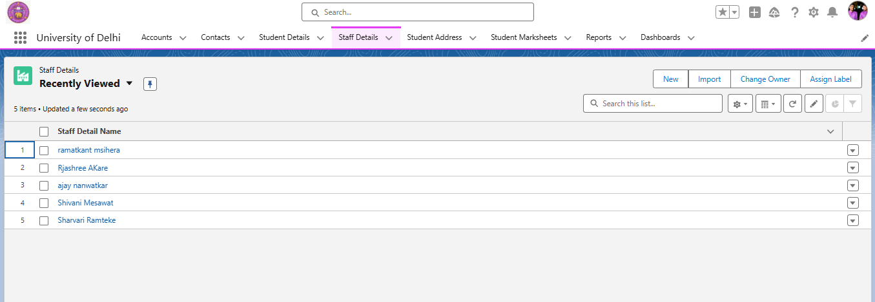
Custom Object – Staff Details Page Layout

Slide 13
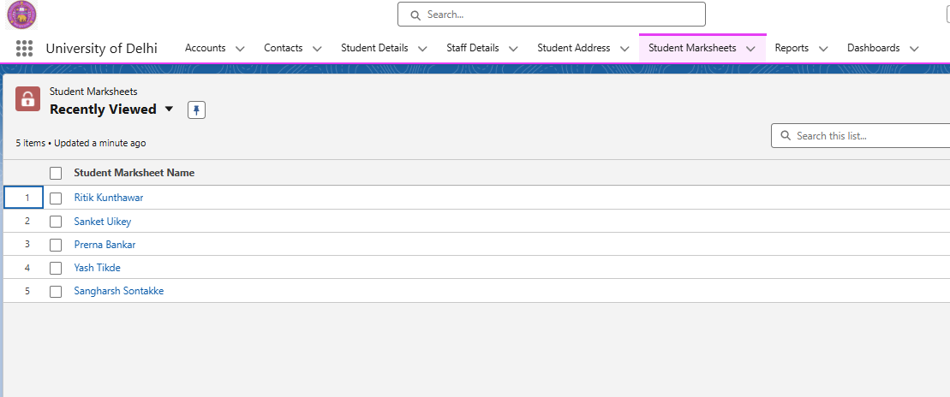
Student Marksheet Page Layout

Slide 14
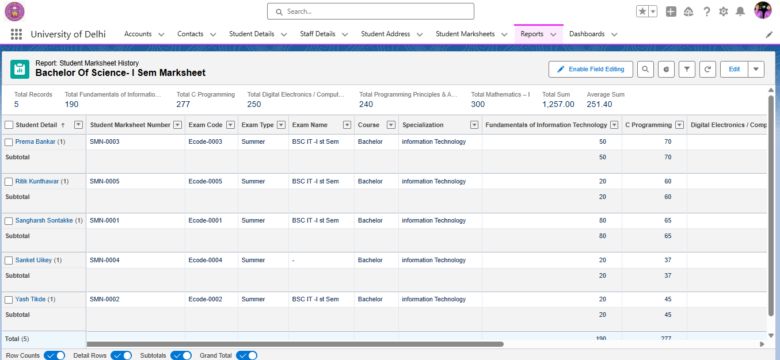
Reports

Slide 15
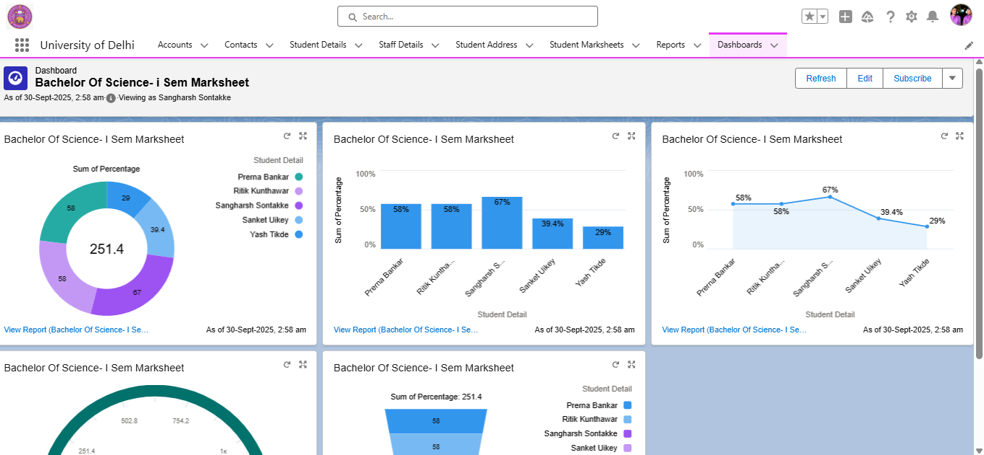
Dashboards

